Slide 1

IMPOSTORS AMONG CREWMATES: LEVERAGING ETW FOR RED TEAM PURPOSES
Presented By: Fletcher Davis

Slide 2
AGENDA
Introduction to ETW
From Blue to Red
Overview of ETW and its components
Repurposing ETW Functionality for Offensive Purposes
Qualifying Normality
Final Thoughts
Using Windows Telemetry to Shift Asymmetries
Conclusion and References

Slide 3
Introduction to ETW

Slide 4
Event Tracing For Windows
Event Tracing for Windows (ETW) provides a mechanism to trace and log events that are raised by user-mode applications and kernel-mode drivers
Introduced in Windows 2000
Originally designed for performance monitoring and debugging
Endpoint security products have begun to leverage ETW to identify malicious activity
Microsoft Defender for Endpoint (MDE) relies heavily on ETW

Slide 5
ETW Controller
Enable/Disable
Event Tracing Session
Events
Log Files
Session 1
Session 2
Session 3
Events in Real-Time
Events
Logged Events
ETW Provider
ETW Consumer

Slide 6
ETW Controllers
Responsible for managing trace sessions, providers, and consumers
Start and stop event tracing sessions
Enables and disables providers within a trace session
Users/Services that can control trace sessions:
Local Administrators
Users in the Performance Log Users group
Services running as LocalSystem, LocalService, or NetworkService

Slide 7
ETW Trace Sessions
Consumer of one or more ETW providers
Events can be consumed in real-time or outputted to .ETL files
Trace sessions have the ability to filter providers are particular events
Event Tracing supports a maximum of 64 event tracing sessions executing simultaneously

Slide 8
ETW Providers
Responsible for generating events and writing them to ETW trace sessions
Providers exist in both userland and the kernel
Providers have unique GUIDs
Applications can register ETW providers and write events to them
Four types of ETW providers:
Manifest-Based Providers
MOF Providers
Windows Software Trace Preprocessor (WPP) Providers
TraceLogging Providers

Slide 9
ETW Providers
Manifest-Based Providers
MOF (Classic) Providers
Use an XML-based manifest to define events so consumers know how to consume them
Referred to as Instrumentation Manifest
Can be enabled by up to eight trace sessions simultaneously
Primary provider for Windows Event Log
Requires channel attribute
Use EventRegister and EventWrite functions to register and write events
Use MOF classes to define events so consumers know how to consume them
Think back to WMI providers
Can be enabled by only one trace session at a time
Use the RegisterTraceGuids and TraceEvent functions to register and write events

Slide 10
ETW Providers
WPP Providers
TraceLogging Providers
Designed for debugging a single binary
Not intended to be consumed for any other purpose
WPP Providers, by design, do not supply an event manifest
Requires reverse engineering to recover
Can be enabled by only one trace session at a time
Use the RegisterTraceGuids and TraceEvent functions to register and write events
Event schema is stored in application binary
Schema is stored in _TraceLoggingMetadata_t structure
Results in larger events and ETL files
Can be enabled by up to eight trace sessions simultaneously
Use TraceLoggingRegister and TraceLoggingWrite functions to register and write events

Slide 11
ETW Consumers
Consumers are applications that collect events from one or more event tracing sessions
Can receive events in multiple ways:
Log files
Trace sessions that deliver events in real-time
A well-known consumer is the Windows Event Viewer

Slide 12
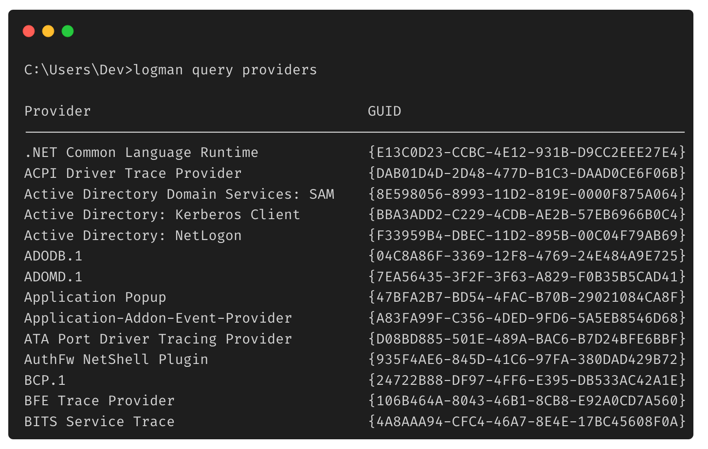
Interacting With ETW: Logman
Logman is a built-in Windows utility for handling ETW and Event Tracing Sessions
Allows you to query, create, start, and stop tracing sessions
Windows comes with more than 1000 registered providers and 12 trace sessions by default

Slide 13
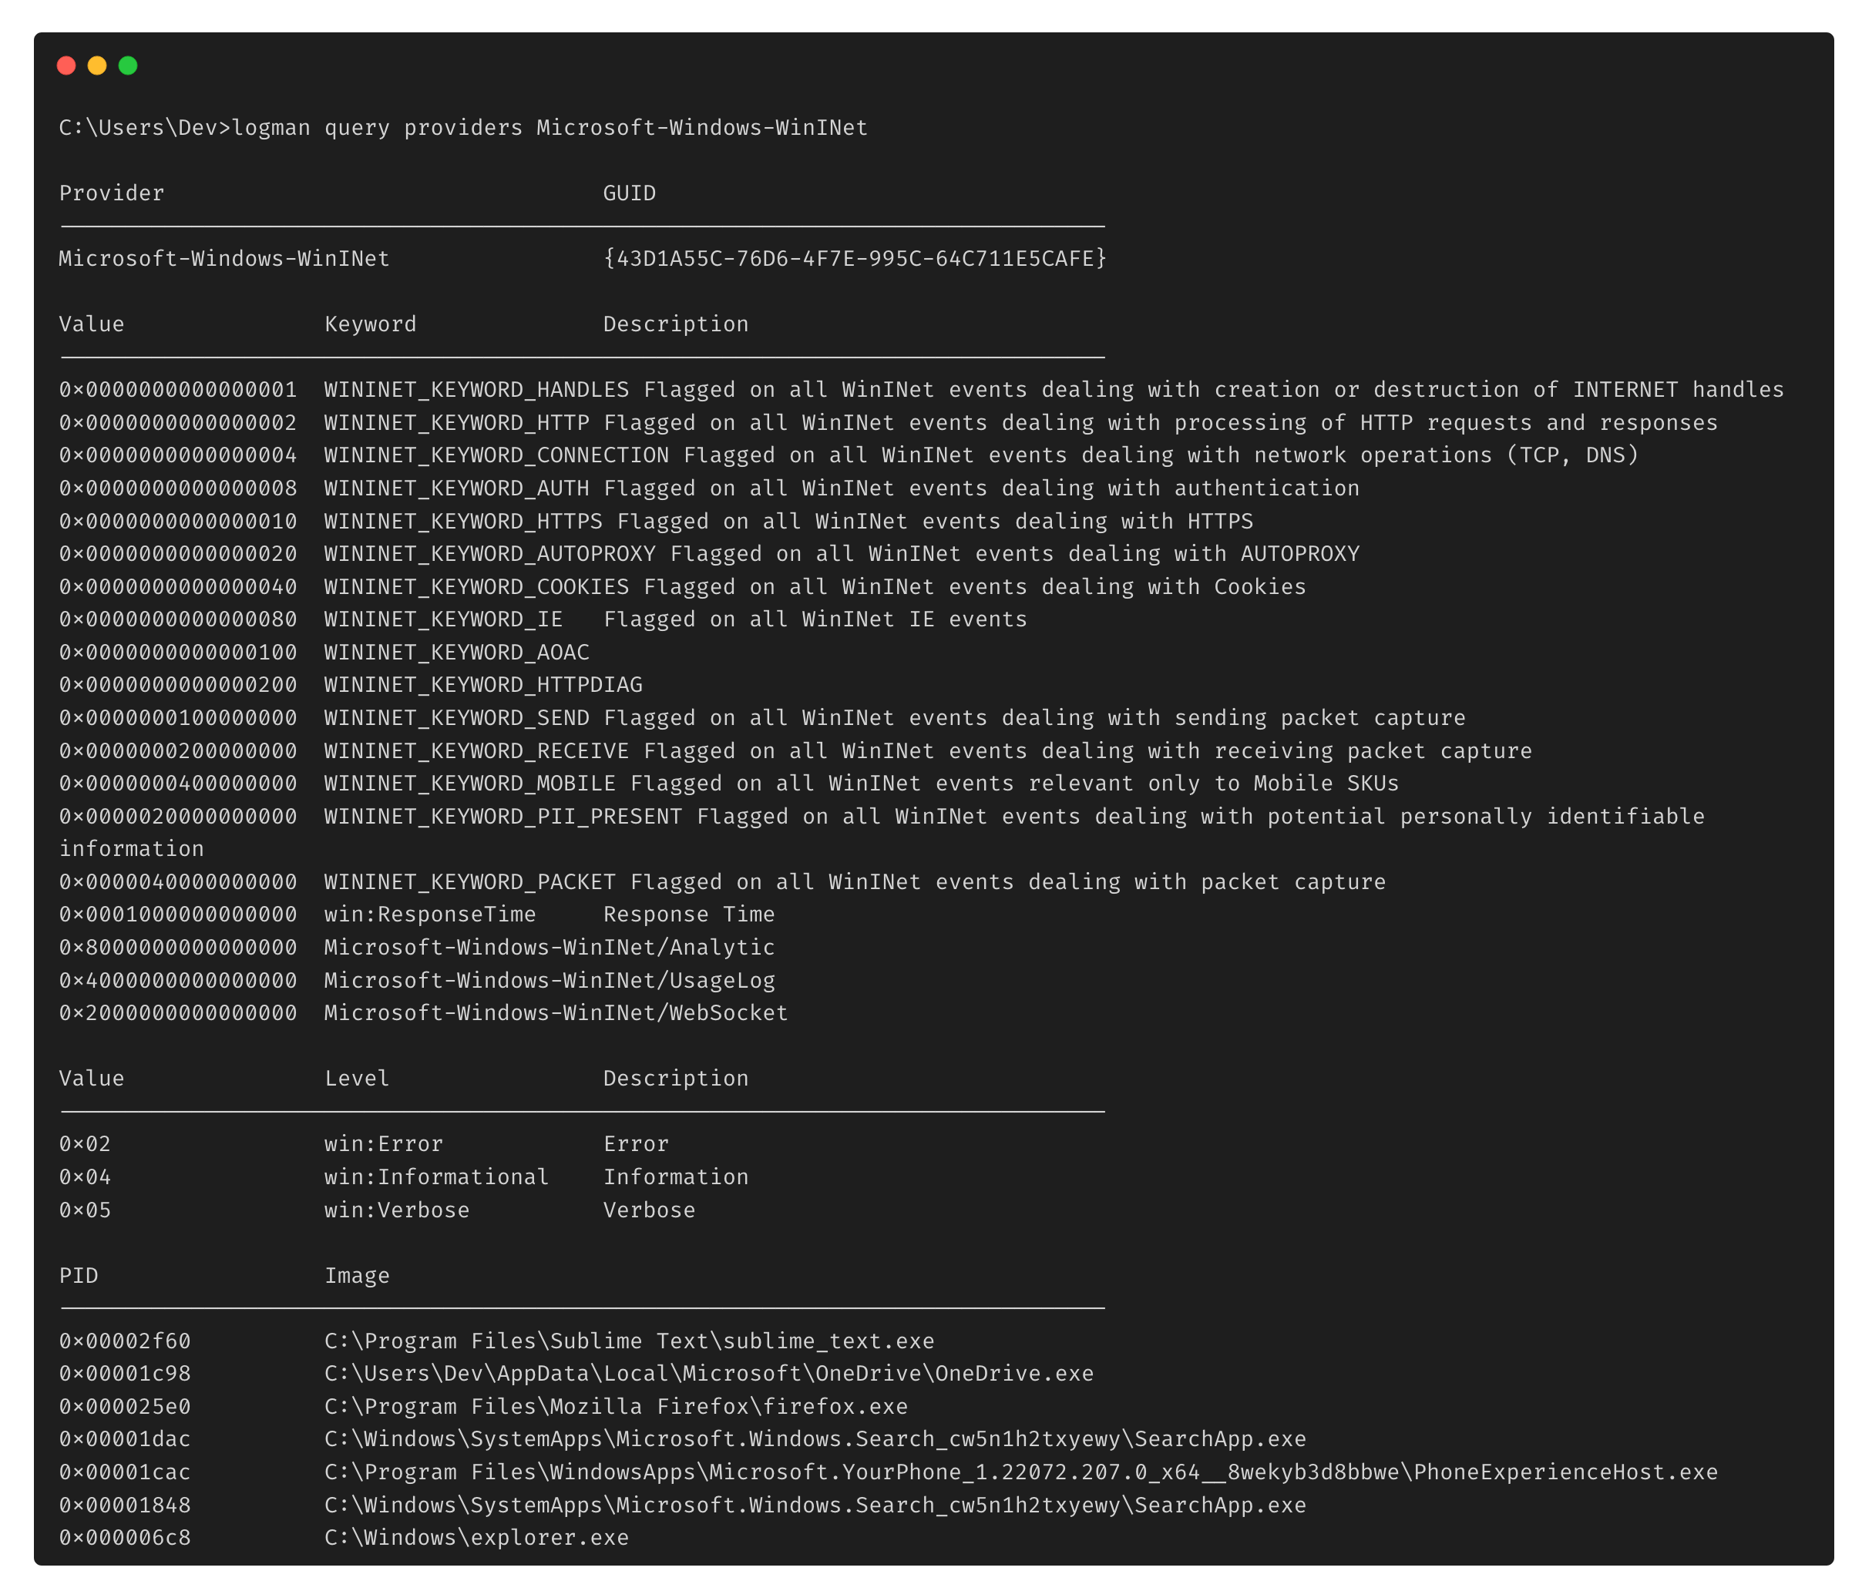
Enumerating Providers

Slide 14
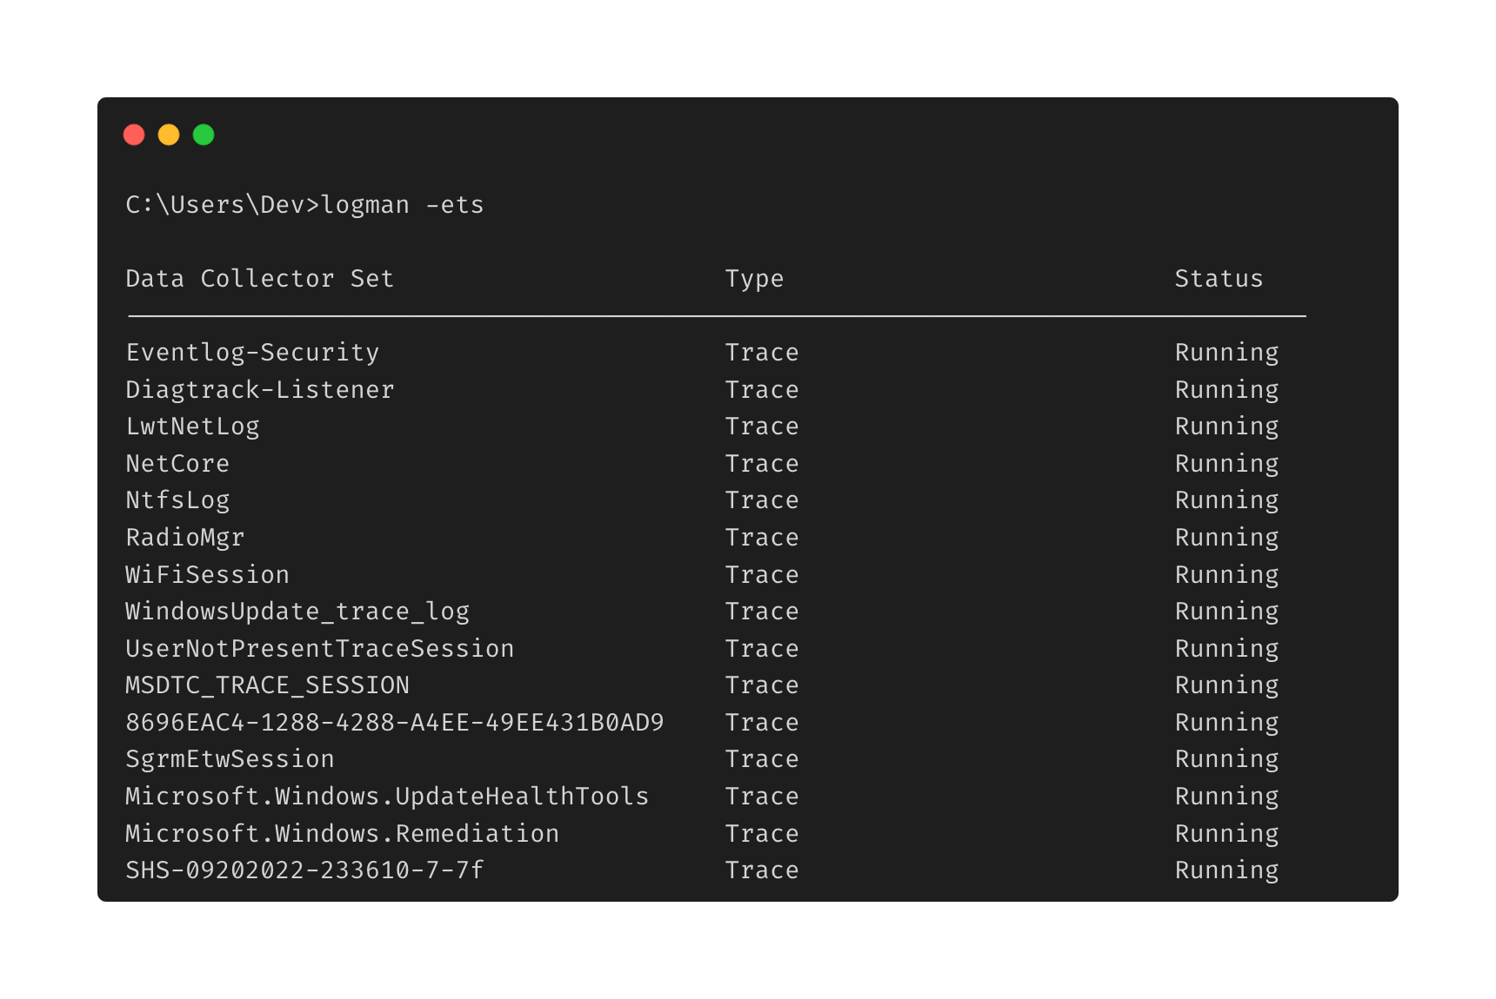
Enumerating Trace Sessions

Slide 15
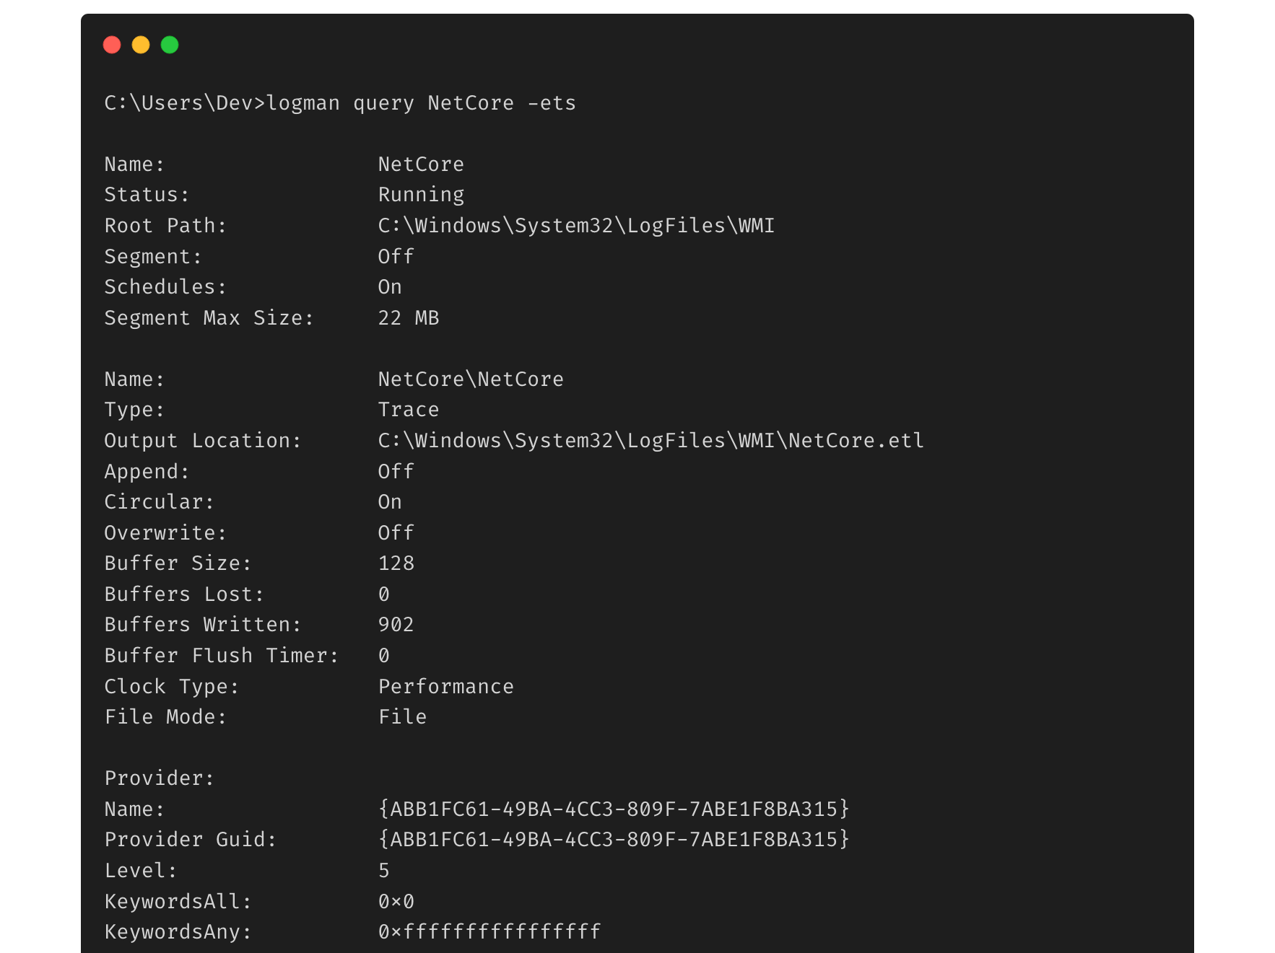
Analyzing Trace Sessions

Slide 16
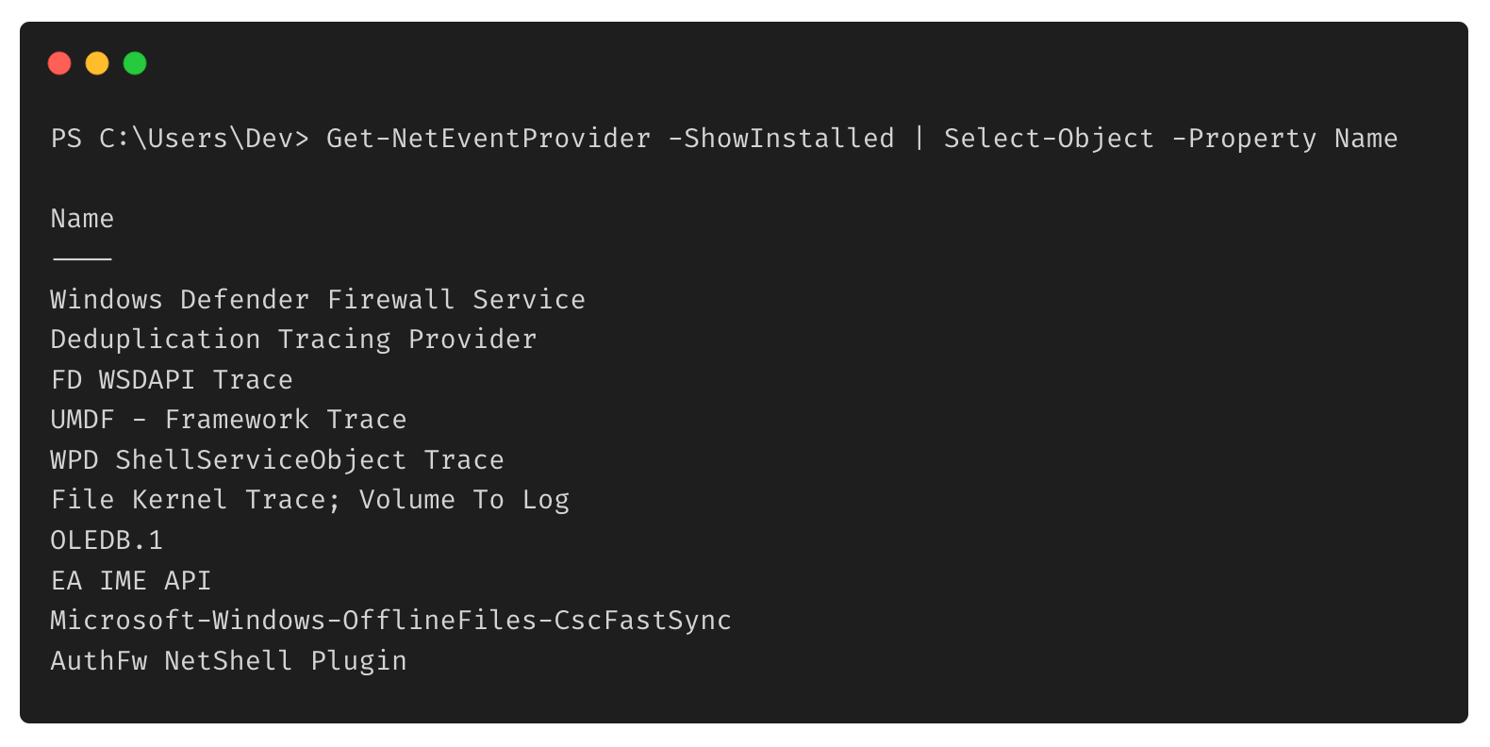
Interacting With ETW: PowerShell
The EventTracingManagement PowerShell module allows you to query, create, start, and stop tracing sessions
The System.Diagnostics.Eventing.Reader Namespace allows you to query providers and specific data about each provider

Slide 17
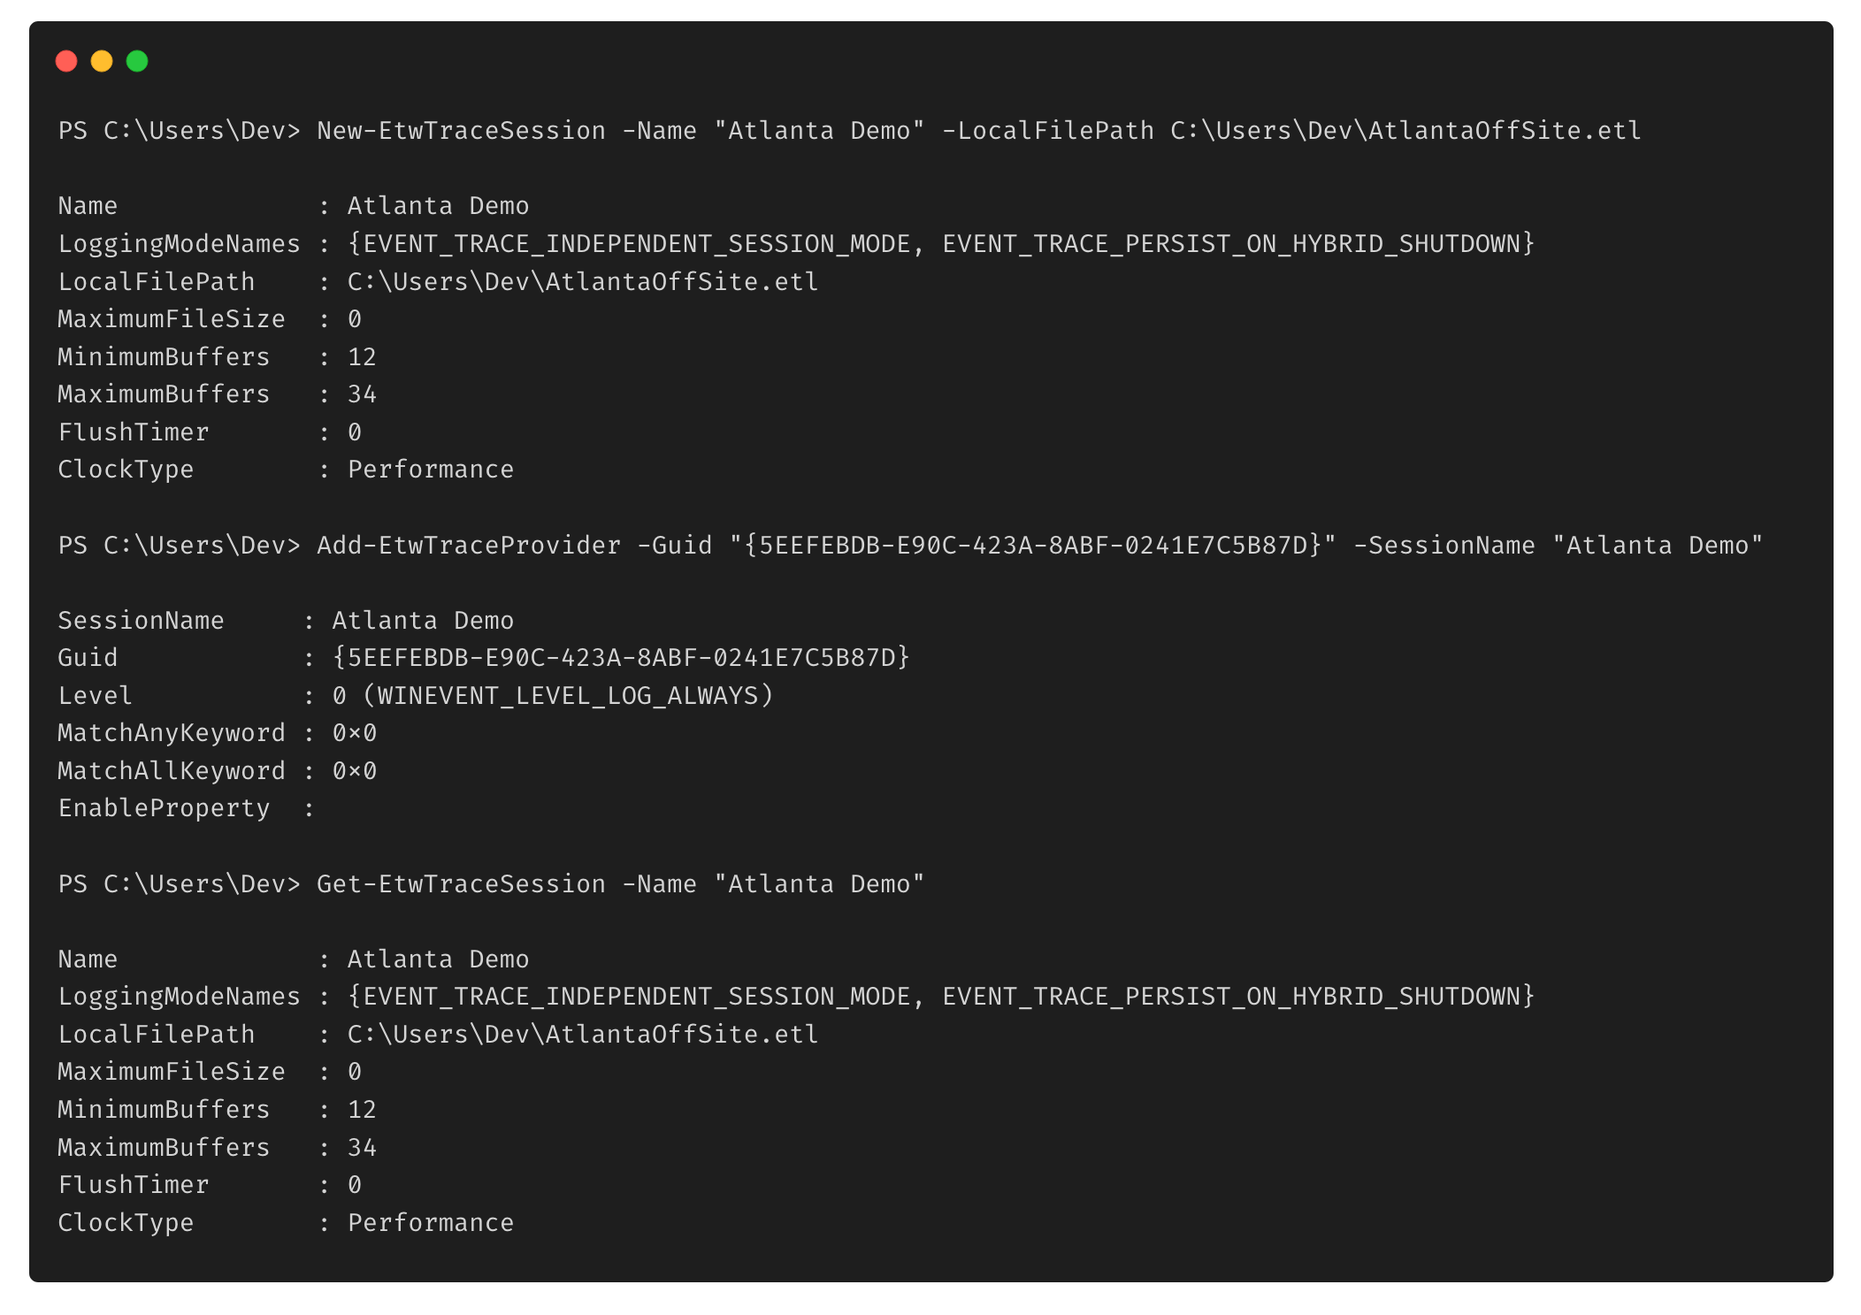
Creating a Trace Session

Slide 18
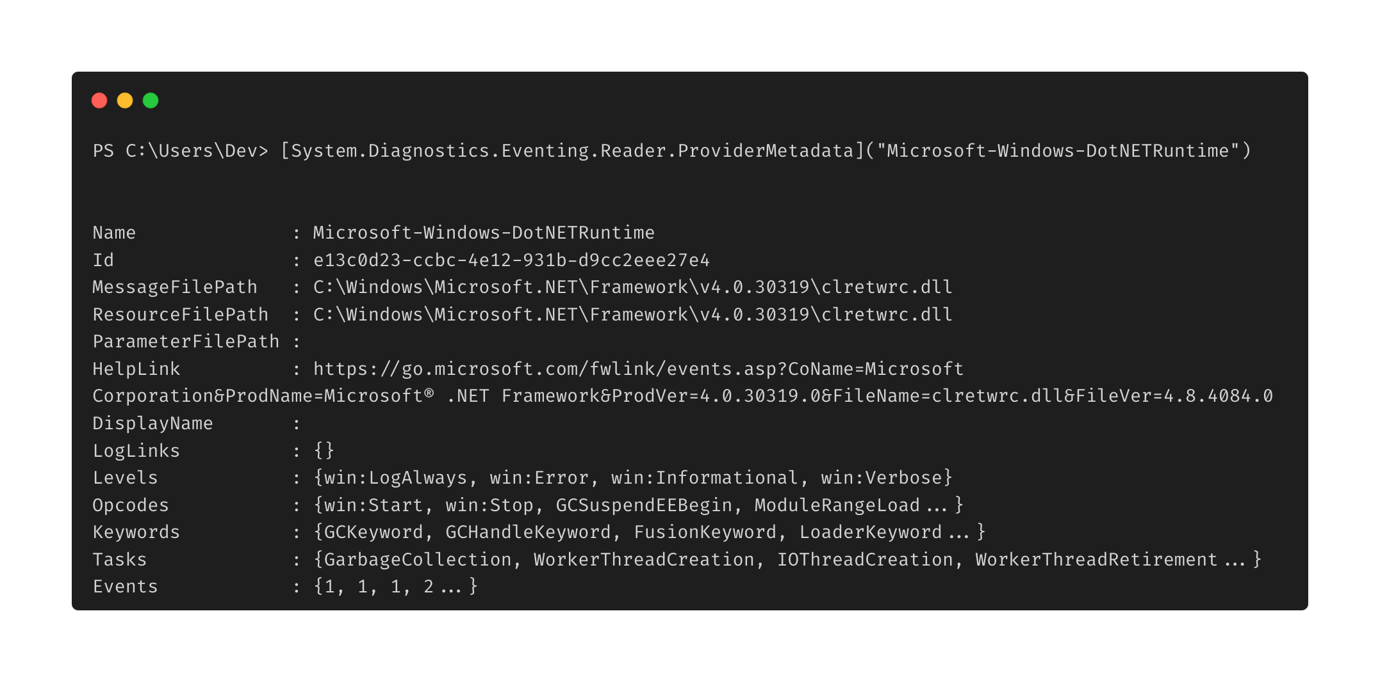
Analyzing Providers

Slide 19
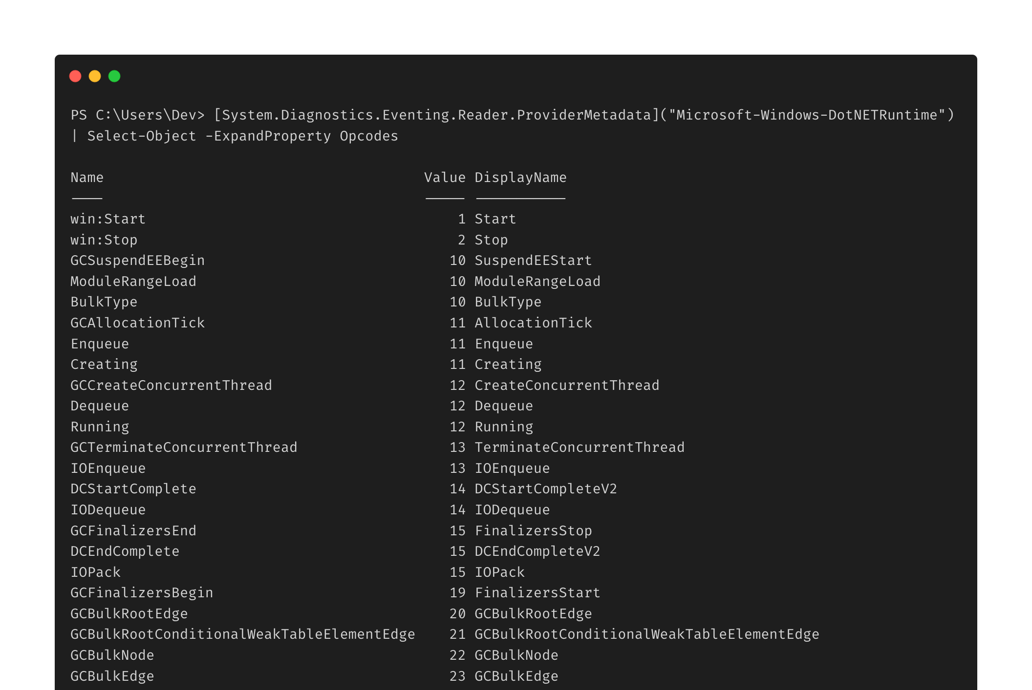
Analyzing Providers

Slide 20
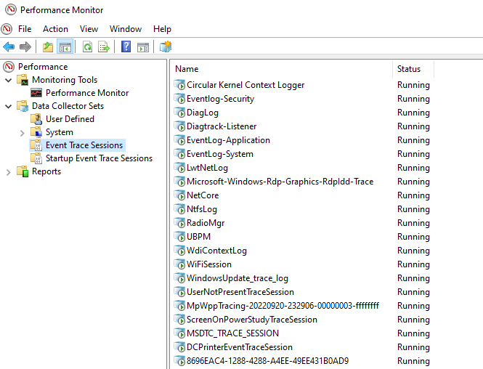
Interacting With ETW: Performance Monitor
Performance Monitor allows for an operator to query, create, and modify ETW trace sessions using a graphical user interface
Other GUI-based applications exist for performing particular ETW-related actions

Slide 21
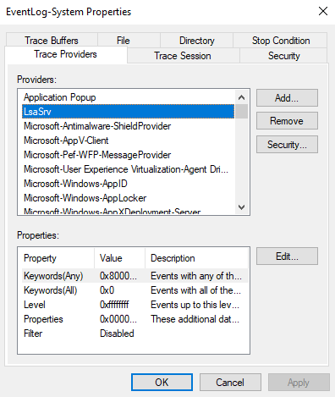
Analyzing And Modifying Trace Sessions

Slide 22
From Blue to Red

Slide 23
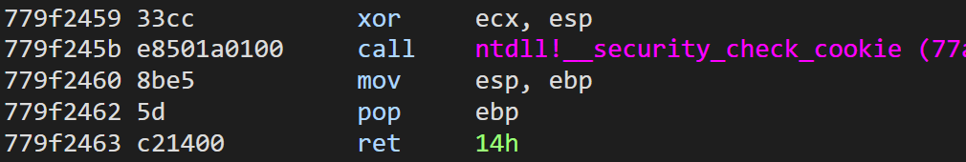
Patching ETW Write Events
Recent research by Adam Chester describes patching the EtwEventWrite function by having it return when the function is called
Prevents the process from writing ETW events to trace sessions monitoring events from particular providers

Slide 24
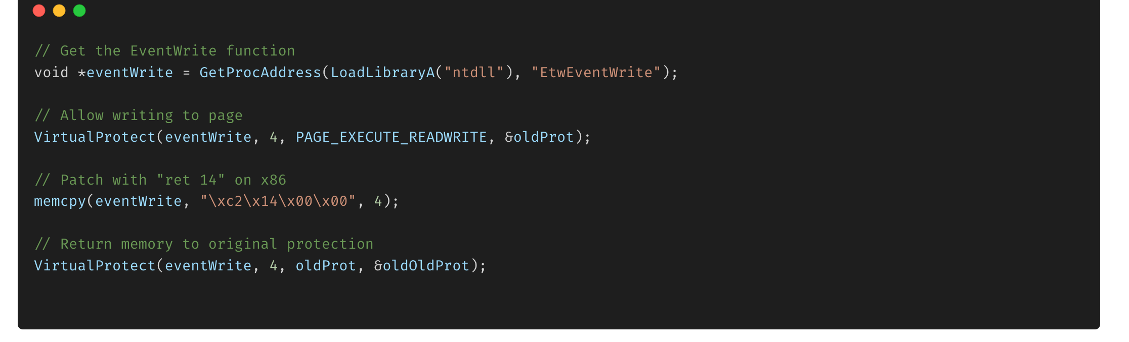
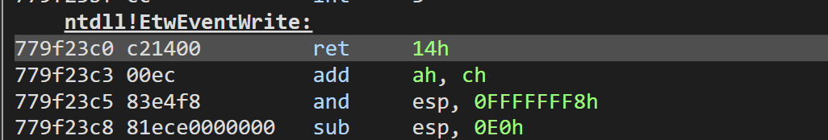
Patching ETW Write Events

Slide 25
Tampering With ETW Write Events: Considerations
Particular EDRs monitor for tampering of the EtwEventWrite function
Cortex XDR
Important to consider how a security product treats a sudden lack of telemetry from a particular source
Ways to potentially circumvent detections around tampering:
Patch the syscall NtTraceEvent
Hook the function and tamper with the input/output from the function
Be conscious of process context
Multiple providers that can write events outside of the EtwEventWrite function

Slide 26
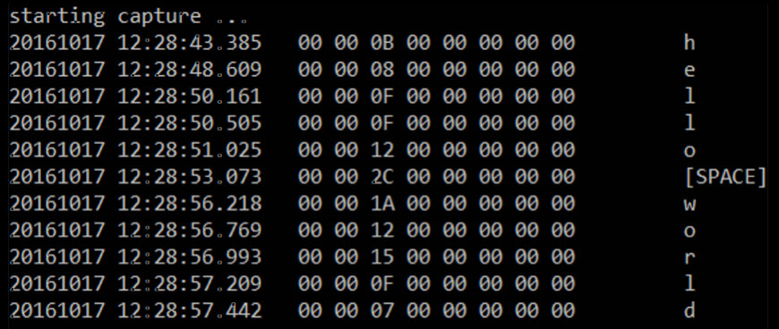
Key Logging With ETW
Two USB ETW Providers are capable of tracking and ingesting mouse and keyboard data
Microsoft-Windows-USB-UCX (36DA592D-E43A-4E28-AF6F-4BC57C5A11E8)
Microsoft-Windows-USB-USBPORT (C88A4EF5-D048-4013-9408-E04B7DB2814A)
Data stored in 8 byte “payloads” from the Human Interface Device (HID) USB device

Slide 27
Credential/Cookie Stealing With ETW
The Microsoft-Windows-WinINet ETW provider leaks sensitive web information in its trace events
Captures all data that passes through the WinINet API
Works with both HTTP and HTTPS traffic
Exposed information includes:
URLs
Cookies
Credentials (POST request parameters)

Slide 28
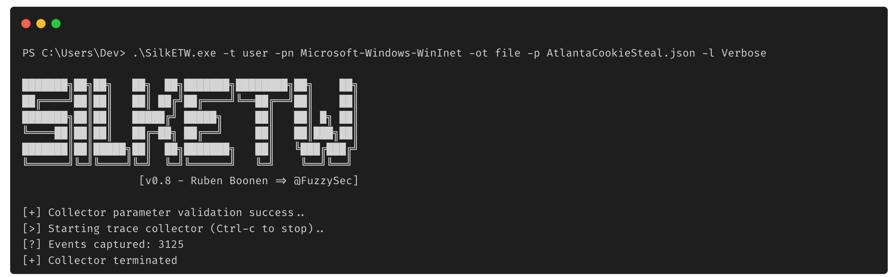
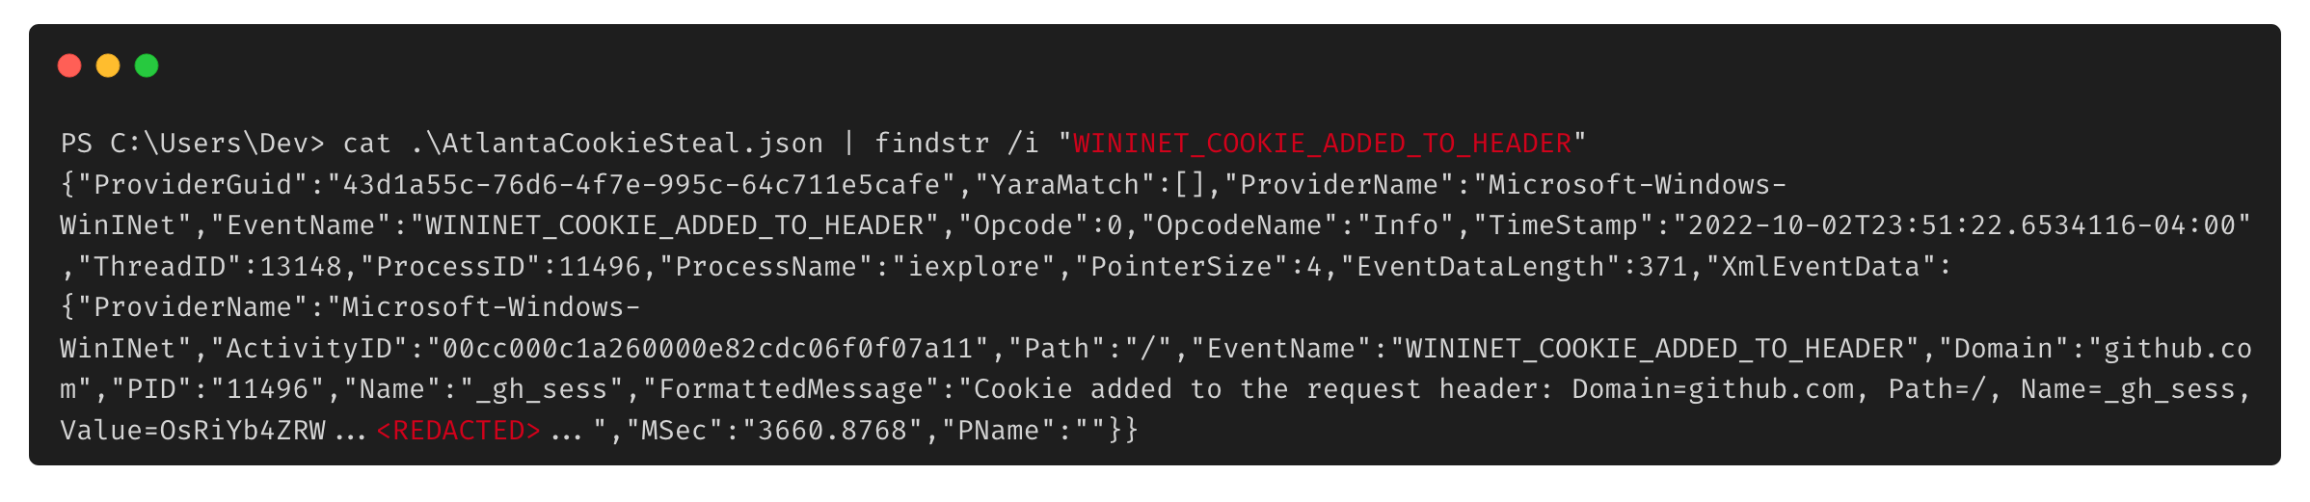
Credential/Cookie Stealing With ETW

Slide 29
Qualifying Normality

Slide 30
Problem We Are Trying to Solve
Defenders have ample knowledge and data on endpoints managed by their organization / across organizations
Sophisticated defenders can leverage this data to identify anomalous behavior
Parent/Child process relationships
Non-web processes making outbound HTTPS connections
How can red teamers leverage Windows telemetry to identify where their malicious activity looks normal?

Slide 31
Introducing “CrowdLight”
Operators can leverage telemetry generated through ETW to identify the benign contexts for otherwise malicious post-exploitation behavior
Understanding this behavior allows operators to make more nuanced tradecraft decisions to better blend-in to the operational environment
Requires operators to analyze and understand what events are generated through particular capability
Ex. Identify applications that normally make outbound network connections to CloudFront
Kind of like what a detection engineer might do, but for offensive purposes

Slide 32
How to play?
Identify ETW Providers and Events of Interest
Create Trace Session and Log Output
Analyze Ingested Data and Profit
Step 1
Step 3
Step 5
Step 2
Step 4
Configure SilkETW to Monitor Providers and Filter on Events
Consume Output to Centralized Analysis Platform

Slide 33
Identify ETW Providers and Events of Interest
Thousands of ETW Providers serve telemetry around different Windows functionality
Examples of ETW Providers containing interesting events:
Microsoft-Windows-Kernel-Process
Microsoft-Windows-LDAP-Client
Microsoft-Windows-WinHttp
Microsoft-Windows-DotNETRuntime
Microsoft-Windows-Kernel-Audit-API-Calls

Slide 34
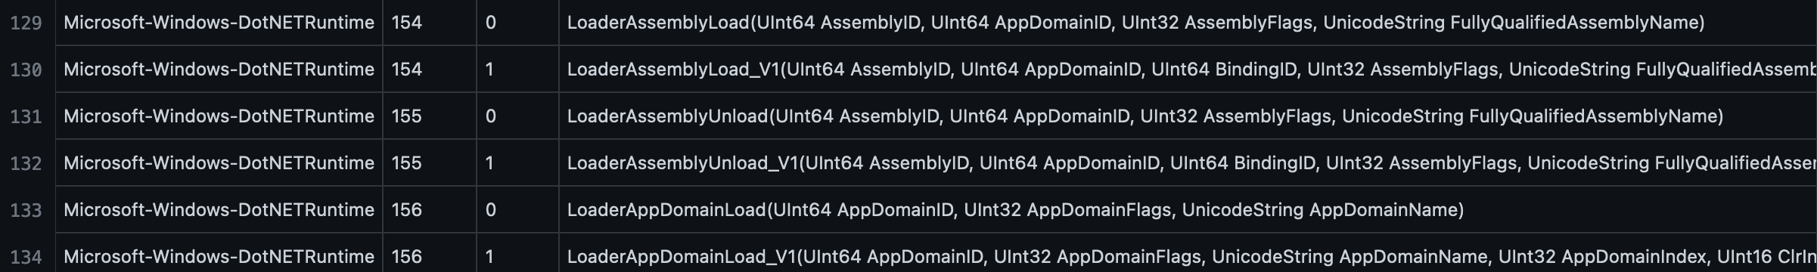
Microsoft-Windows-DotNETRuntime Provider
The Microsoft-Windows-DotNETRuntime ETW provider monitors events around the CLR runtime. Events we are interested in include:
Event ID 141/152: Module Load
Event ID 142/153: Module Unload
Event ID 154/155: Assembly Load / Unload
Event ID 156/157: AppDomain Load / Unload

Slide 35
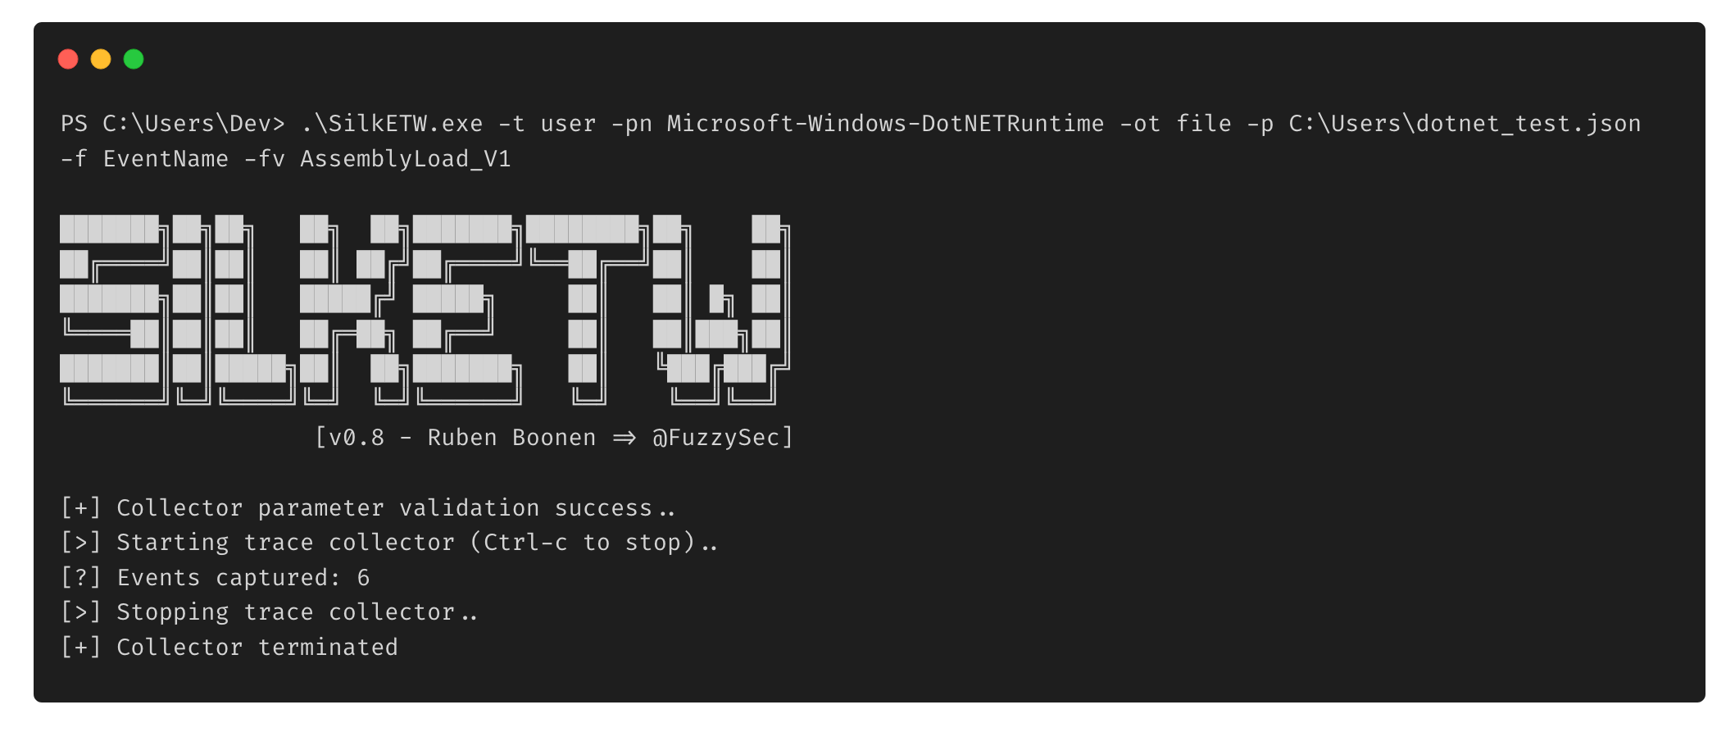
Configuring SilkETW
Filter on Event Names
Output JSON File
Userland Provider
ETW Provider
Filter on Assembly Loading Events

Slide 36
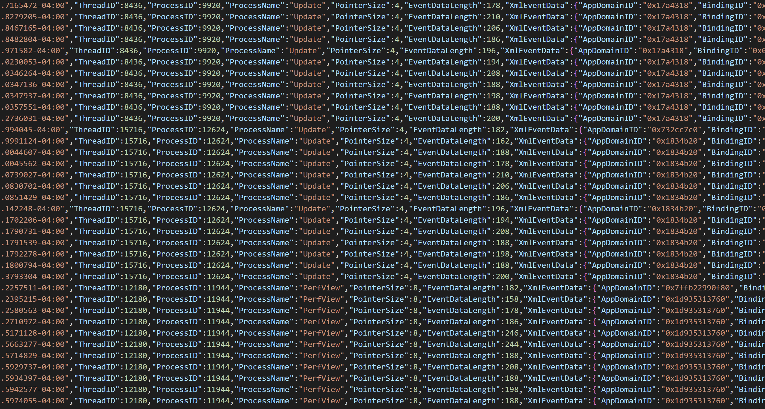
Create Trace Session and Log Output

Slide 37
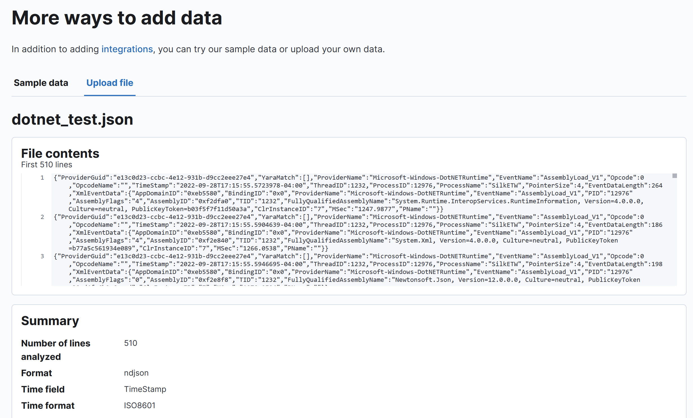
Consume Output to Centralized Analysis Platform

Slide 38
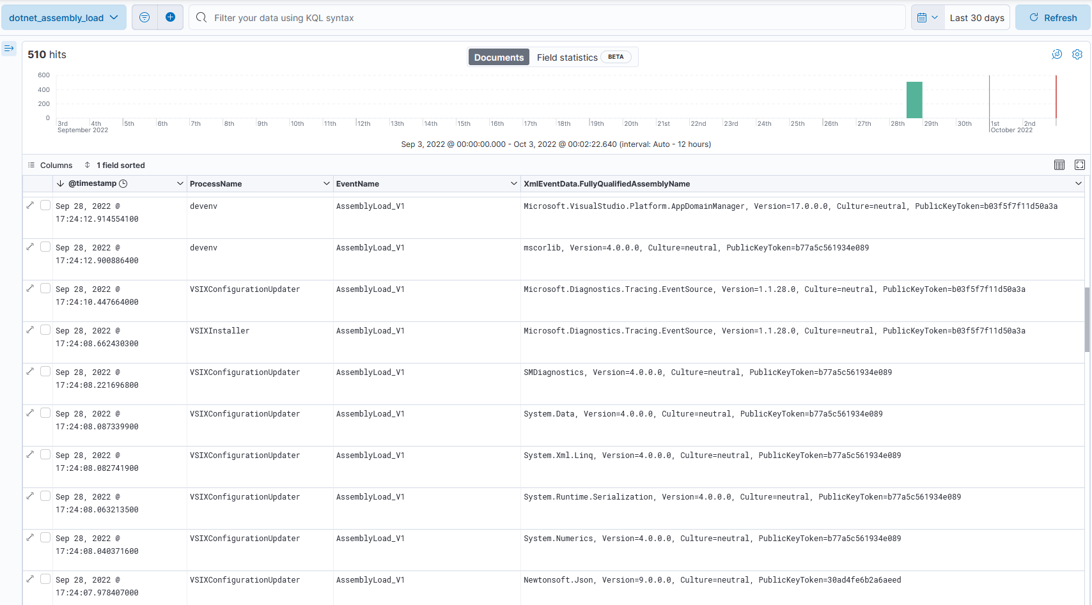
Analyze Ingested Data and Profit
Process Name
Event Name
Loaded Assembly Name

Slide 39
Final Thoughts

Slide 40
Conclusion
ETW is a treasure trove of insight into the telemetry generated by operational capabilities
Leveraging this insight allows us to identify stronger process contexts and reinforce operational decisions
”CrowdLight” provides a foundation for further research into additional telemetry sources that can provide additional insight into similar behaviors
ETW TI, Kernel Callbacks, Userland Hooks, etc.

Slide 41
References
https://blog.palantir.com/tampering-with-windows-event-tracing-background-offense-and-defense-4be7ac62ac63
https://bmcder.com/blog/a-begginers-all-inclusive-guide-to-etw
https://nasbench.medium.com/a-primer-on-event-tracing-for-windows-etw-997725c082bf
https://github.com/jdu2600/Windows10EtwEvents
https://twitter.com/domchell/status/1506365918556962832
https://ruxcon.org.au/assets/2016/slides/ETW_16_RUXCON_NJR_no_notes.pdf
https://github.com/mandiant/SilkETW
https://whiteknightlabs.com/2021/12/11/bypassing-etw-for-fun-and-profit/
https://www.mdsec.co.uk/2020/03/hiding-your-net-etw/

Slide 42

Thank You For Listening

